Slide 1

MERCIGLOBAL
Cloud ERP
AI-Powered Business Operations
for the Modern Enterprise
Smarter Dashboards · Operational Insights · Real-Time Pendency Alerts
Transforming Industries · Empowering Decisions

Slide 2



AI ADVANTAGE
How Merciglobal Cloud ERP leverages Artificial Intelligence
Three core pillars that make your operations smarter every day
AI-Assisted Dashboard Generation
Operational Pendency Alerts
Business Intelligence Widgets
Management dashboards built dynamically with AI-recommended layouts — critical KPIs surfaced automatically, not buried in spreadsheets. Role-aware views for directors, managers and operators.
AI continuously monitors every operator's task queue and flags pending work in real time — automatically escalating overdue tasks to management before they become disruptions.
AI-generated insight widgets expose revenue trends in ₹ Cr, inventory risks, GST compliance status, and process bottlenecks as actionable visual blocks on your dashboard.
MERCIGLOBAL CLOUD ERP · AI-Powered Business Operations

Slide 3
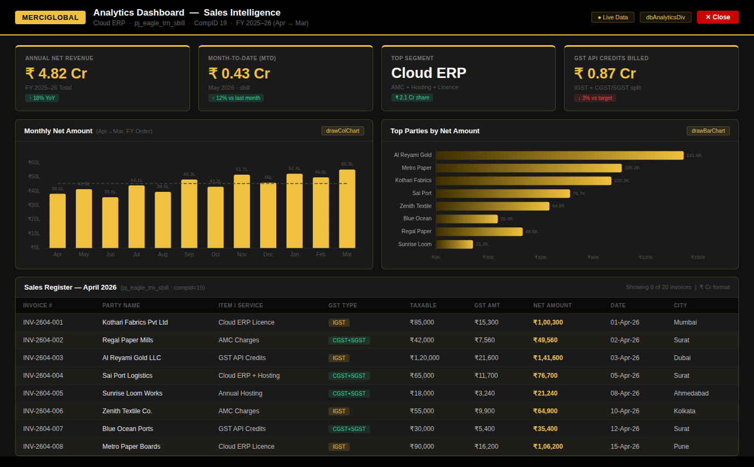
LIVE SCREEN
Analytics Dashboard — Sales Intelligence
ECharts · drawColChart / drawBarChart · ₹ Cr format · FY 2025–26 (Apr → Mar) · pj_eagle_trn_sbill · CompID 19

Slide 4
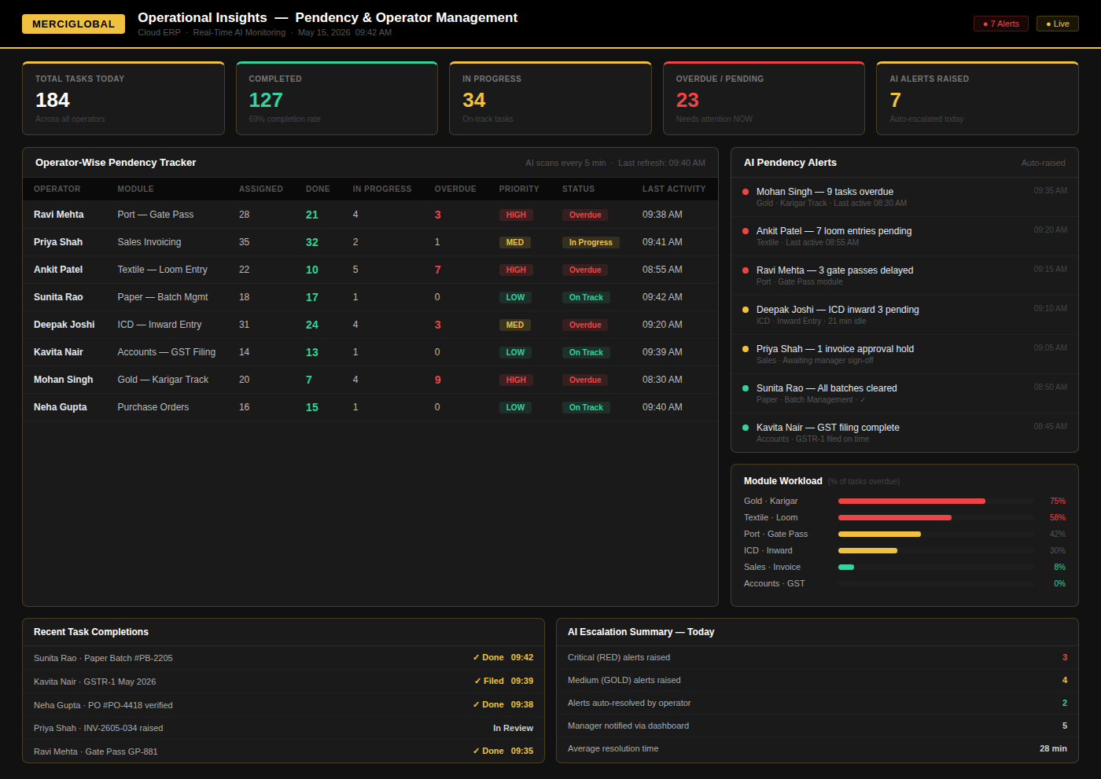
LIVE SCREEN
Operational Insights — Pendency & Operator Management
Real-Time AI Monitoring · Operator-Wise Pendency Tracker · Auto-Escalation Alerts · Module Workload Analysis

Slide 5







AI Capabilities Deep Dive
The intelligent engine powering every module of Merciglobal Cloud ERP
Smart Layout Engine
Predictive Analytics
Anomaly Detection
Analyses management role and live data patterns to recommend the optimal dashboard layout — zero manual configuration required.
Identifies trends in sales (₹ Cr), production, and logistics to give forward-looking business intelligence every morning.
Flags unusual patterns in financial transactions, inventory movements, and operator behaviour before they escalate.
Workflow Automation
Real-Time Data Fusion
Mobile-Ready Insights
Automates approvals, notifications, and escalations based on business rules and AI-detected conditions.
Merges live data from all ERP modules (Textile, Port, Gold, Paper) into unified insight widgets updated continuously.
Management gets AI insights on any device — dashboards and pendency alerts work seamlessly on mobile, tablet, and desktop.
MERCIGLOBAL CLOUD ERP · AI-Powered Business Operations

Slide 6

Industries We Transform
Our Reach
5+
Textile & Loom
Industries Served
Production tracking, yarn stock, GST compliance & loom efficiency dashboards (pj_silkpolyfab_)
Paper Industry
Multi
Batch management, raw material consumption, quality control & production insights
Country Deployments
Port & Logistics
ICD gate movement, berth allocation, inward/outward tracking & operator task management (pj_icd_)
Cloud
Gold & Jewellery
Native Architecture
Dubai gold-sector ERP: karigar tracking, inventory purity, custom reporting & IGST compliance
AI
Manufacturing
Production planning, shop floor control, purchase orders & delivery tracking
Powered Core
MERCIGLOBAL CLOUD ERP · AI-Powered Business Operations

Slide 7

Operational Insights & Pendency Management
AI monitors every operator's workload — identifying delays before they become disruptions
How AI-Driven Pendency Management Works
01
02
03
04
Task Assignment
AI Monitoring
Pendency Detection
Alert & Escalate
Every work item assigned to an operator with expected timelines tracked in the ERP system.
AI continuously scans task queues, deadlines, and operator activity every 5 minutes.
Overdue or stalled tasks flagged automatically — no manual follow-up needed by managers.
Management gets targeted alerts on dashboards highlighting exactly where attention is critical.
Key Operational Benefits
↓ 40%
100%
Real-Time
Zero
Reduction in task delays
Operator workload visibility
Pendency alerts to managers
Manual follow-up required
MERCIGLOBAL CLOUD ERP · AI-Powered Business Operations

Slide 8

Industry-Specific Customisation
Textile, paper, port, gold, manufacturing — every module is purpose-built for your domain, not a generic fit.
GST & Compliance Built-In
GSTR-1, GSTR-3B, e-Way Bill automated — backed by backtick-safe SQL queries and real-time GST API credits.
AI That Learns Your Business
The AI adapts to your operational patterns over time, getting smarter with every data point your team generates.
Why Choose
Merciglobal
Cloud ERP?
Rapid Cloud Deployment
Cloud-native architecture means faster go-live. New clients operational within weeks, not months.
Dedicated Development Team
Built for Indian & Global Enterprises
A committed team behind every deployment — custom feature development, training, and ongoing support included.
MERCIGLOBAL CLOUD ERP · AI-Powered Business Operations

Slide 9
Ready to Transform Your
Business Operations?
Experience AI-powered dashboards, real-time operational insights,
and intelligent pendency management — built for your industry.
Schedule a Live Demo Today
MERCIGLOBAL SYSTEMS PVT LTD · Cloud ERP · AI-Powered · Gold #F0C13E · Industry Specialists

