Slide 1


End-to-End Merciglobal Cloud ERP Solution for EPC Organizations
ENGINEERING
PROCUREMENT
CONSTRUCTION
MANUFACTURING
QUALITY
LOGISTICS
FINANCE
Driving Control Across the Complete EPC Lifecycle

Slide 2

What This ERP Delivers
A fully integrated, project-centric Merciglobal Cloud ERP platform designed specifically for EPC businesses managing complex, multi-project environments. This comprehensive solution unifies every aspect of your operations—from initial tender to final handover—within a single, intelligent system that adapts to the unique demands of engineering, procurement, and construction workflows.
Centralized Control
Real-Time Visibility
Cross-Functional Integration
Live Profitability Tracking
Manage multiple projects simultaneously with unified oversight and resource allocation
Track costs, materials, and progress across all projects instantly
Break down silos between engineering, procurement, and execution teams
Monitor project margins and financial performance as work progresses
Data-Driven Decisions
Empower leadership with actionable insights and predictive analytics

Slide 3

Operational Realities in EPC
The EPC industry operates in one of the most demanding business environments, where complexity is the norm rather than the exception. Organizations routinely juggle multiple concurrent projects, each with its own timelines, budgets, and resource requirements. This creates a perfect storm of operational challenges that traditional management approaches simply cannot address.
The Consequence
Margin erosion, project delays, and reduced predictability become inevitable outcomes. Organizations find themselves constantly firefighting rather than executing strategically, leading to customer dissatisfaction and competitive disadvantage.
Multiple Concurrent Projects
Shared resources across projects lead to allocation conflicts and scheduling complexity
BOQ Visibility Gaps
Disconnect between Bill of Quantities planning and actual execution creates cost overruns
Procurement Delays
Material delivery uncertainties directly impact critical path schedules
Departmental Silos
Fragmented data across teams prevents holistic project understanding
Limited Cost Control
Delayed financial visibility makes proactive intervention impossible
Reactive Decision-Making
Lack of real-time data forces management to respond to problems after they occur

Slide 4

Why Traditional Systems Fail
Most EPC organizations attempt to manage their operations using a patchwork of disconnected tools—spreadsheets, standalone accounting software, and department-specific applications. This fragmented approach creates more problems than it solves, leaving critical gaps in visibility, control, and coordination.
Disconnected Tools Across Departments
Engineering uses one system, procurement another, and finance a third—with no seamless data flow between them
Manual BOQ and Material Tracking
Excel-based tracking of quantities and materials leads to version control issues and human errors
Delayed Management Reporting
Critical insights reach decision-makers days or weeks after events occur, making intervention ineffective
Weak Engineering–Procurement Integration
Design changes don't automatically trigger procurement updates, causing material mismatches
No Unified Project-Wise Costing
True project profitability remains hidden until project closure—too late to course-correct
EPC requires a project-driven ERP—not a generic accounting system. The unique nature of project-based operations demands purpose-built solutions that understand the interconnected nature of engineering, procurement, and construction activities.

Slide 5


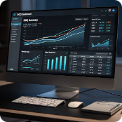
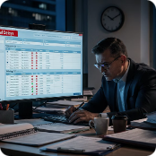
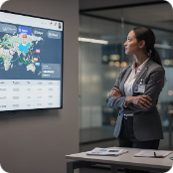

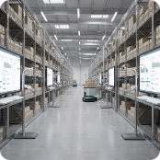

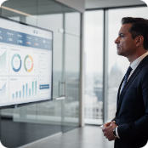



Transformation Through Merciglobal Cloud ERP
Before: Manual Tender Costing
After: BOQ-Driven Estimation
Before: Procurement Uncertainty
After: Lead-Time Tracking
Estimators spend days gathering data from multiple sources, creating spreadsheets prone to errors and inconsistencies
Automated costing pulls from historical data, supplier rates, and resource libraries for accurate, rapid estimates
No visibility into vendor lead times or delivery status creates constant expediting and schedule anxiety
Real-time vendor performance monitoring and delivery tracking enables proactive schedule management
Before: Stock Mismatches
After: Project-Wise Inventory
Before: Delayed Cost Discovery
After: Real-Time Margin Tracking
Materials get lost in the warehouse, allocated to wrong projects, or discovered missing at critical moments
Every material tracked by project, location, and batch ensures right materials reach right sites on time
Cost overruns only surface during monthly closures when corrective action is too late
Live profitability visibility enables immediate intervention when costs deviate from plan
Before: Siloed Departments
After: Integrated Workflows
Teams work independently with different data sources, creating coordination gaps and conflicts
Unified platform connects all departments with shared data, automated handoffs, and seamless collaboration
Outcome: Organizations achieve predictable execution with stronger margins, transforming from reactive crisis management to proactive strategic control.

Slide 6

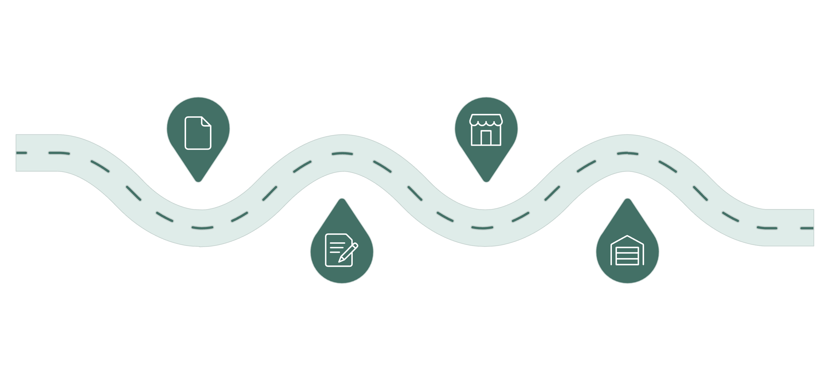

End-to-End EPC Lifecycle in ERP
Merciglobal Cloud ERP creates a single, unified data flow that connects every phase of your EPC operations. From the moment a tender enquiry arrives to final maintenance and analytics, every transaction, decision, and activity is captured, tracked, and connected within one intelligent system. This seamless integration eliminates data re-entry, reduces errors, and provides unprecedented visibility across your entire organization.
Tender
Procure
Manage bids and approvals
Plan purchases and suppliers
Design
Inventory
Create and review engineering plans
Control parts and materials
This integrated approach means that a design change in engineering automatically triggers updates in procurement, inventory adjustments, production planning revisions, and cost recalculations—all happening in real-time without manual intervention. The result is an organization that moves faster, makes better decisions, and delivers projects with greater predictability and profitability.

Slide 7

Sales & Tendering
Structured Bid Management
Transform your tender management from a chaotic, spreadsheet-driven process into a structured, repeatable system that accelerates bid preparation while improving accuracy. The Sales & Tendering module captures every enquiry, tracks all revisions, and maintains complete audit trails of quotations and approvals.
01
Business Value
Enquiry & Tender Tracking
Organizations report significantly faster bid turnaround times—from weeks to days—while simultaneously improving costing accuracy. By leveraging historical project data and automated calculations, estimators produce more competitive, profitable quotations with greater confidence.
Centralized repository for all incoming opportunities with status tracking and deadline alerts
02
The structured approach also creates organizational learning, as each bid's assumptions and outcomes are captured for future reference, continuously improving your competitive positioning.
BOQ-Based Cost Estimation
Automated costing leveraging historical data, current supplier rates, and resource libraries
03
Revision & Approval Workflows
Version-controlled quotations with configurable approval hierarchies and change tracking
04
Quotation Management
Professional quotation generation with terms, conditions, and technical specifications
05
Order Conversion
Seamless transition from quotation to confirmed order with automatic project initiation
06
Milestone-Based Billing Planning
Define payment schedules linked to project milestones for effective cash flow management

Slide 8


Project Management
Complete Project Governance
The Project Management module serves as the central nervous system of your EPC operations, providing complete visibility and control over every aspect of project execution. From initial scope definition through final delivery, every activity, resource, and decision is tracked within a comprehensive project framework that ensures nothing falls through the cracks.
BOQ & Scope of Work Control
WBS & Milestone Mapping
Master Bill of Quantities with change management and revision tracking ensures scope clarity and prevents creep
Work Breakdown Structure defines clear deliverables and milestones for structured execution planning
Schedule Tracking
Material Planning
Integrated timeline management with dependency mapping, critical path analysis, and delay alerts
Automated material requirement planning based on BOQ ensures timely procurement and availability
MOM & Document Control
Drawing Traceability
Centralized repository for Minutes of Meeting, approvals, and project correspondence with full audit trail
Version-controlled engineering drawings linked to BOQ items and procurement specifications
Value Delivered: End-to-end visibility and accountability across all project stakeholders, transforming project management from reactive coordination to proactive orchestration.

Slide 9

Procurement & Supply Chain Management
Vendor & Purchase Control
Procurement delays are the leading cause of schedule slippage in EPC projects. The Procurement & SCM module addresses this challenge head-on by providing complete visibility into vendor performance, delivery timelines, and material availability. Every purchase order is tracked from requisition through delivery, with automated alerts for delays and deviations.
Vendor Enquiries & Comparison
Procurement Transformation
1
Multi-vendor RFQ management with technical and commercial comparison matrices
The system's vendor performance analytics enable data-driven supplier selection, moving beyond relationship-based decisions to objective performance metrics. Historical delivery performance, quality records, and pricing trends inform every procurement decision.
PO with Technical Specs
Automated lead-time monitoring provides early warning of potential delays, allowing procurement teams to take corrective action before schedule impacts occur. This proactive approach reduces expediting costs and improves on-time delivery rates significantly.
2
Purchase orders automatically populated with engineering specifications and quality requirements
3
Lead-Time Monitoring
Real-time tracking of vendor commitments against actual delivery performance
4
Delivery Tracking
Complete visibility into material in-transit, expected arrivals, and delivery exceptions
5
Subcontractor Billing
Work order-based billing for subcontractors with progress measurement and payment tracking
6
Vendor Performance Tracking
Automated scorecarding based on quality, delivery, pricing, and responsiveness metrics
Value Delivered: Reduced procurement cycle times, improved delivery predictability, and enhanced transparency across the entire supply chain.

Slide 10

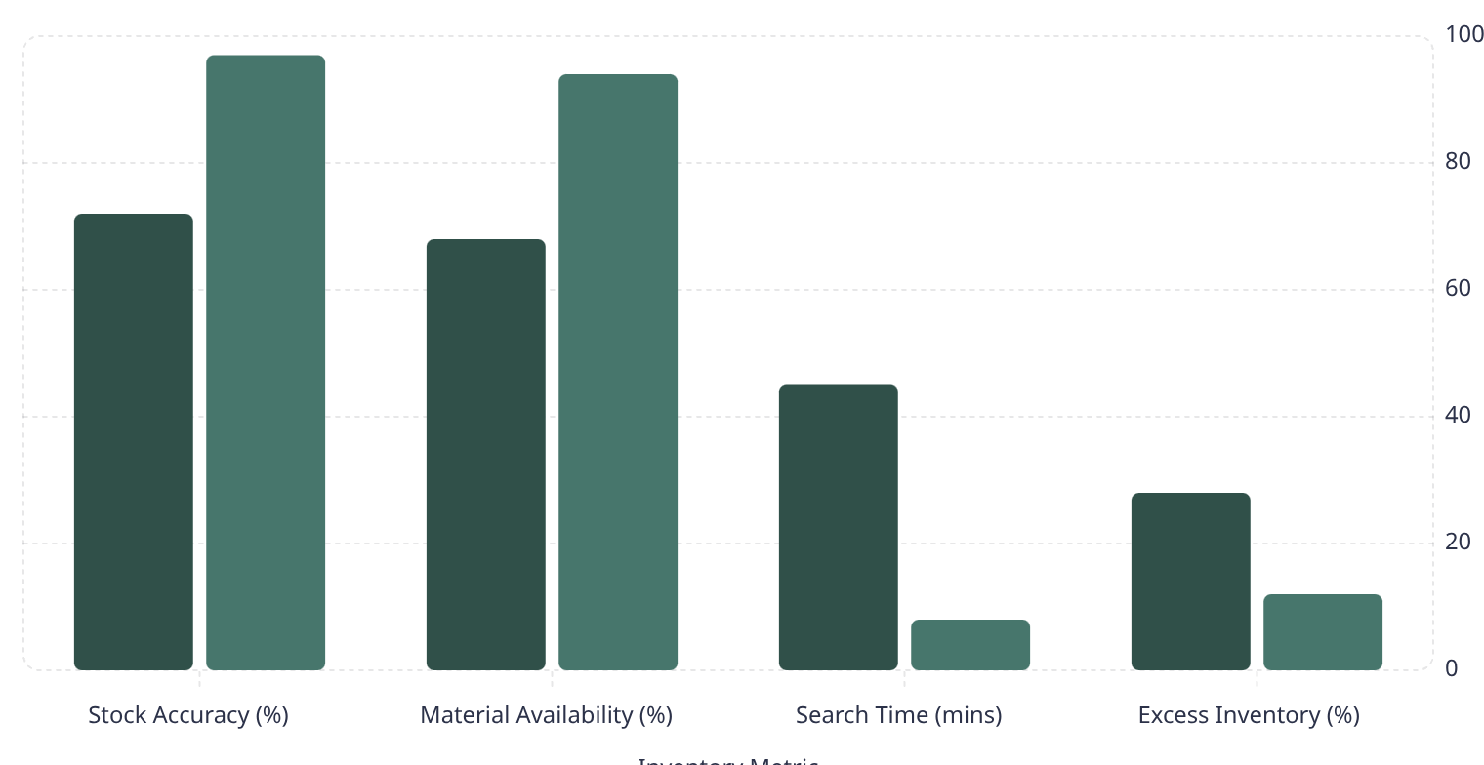
Inventory & Warehouse Management
Real-Time Material Control
Effective inventory management is critical in EPC operations where projects share common materials, yet each project's requirements must be tracked separately. The Inventory & Warehouse module provides project-wise material tracking while maintaining overall stock visibility, ensuring materials are available when needed without excessive inventory investment.
GRN with Quality Validation
Rack/Bin/Location Tracking
Batch & Serial Traceability
Project-Wise Allocation
Goods Receipt Notes integrated with incoming quality inspection for acceptance control
Multi-level location management ensures rapid material retrieval and accurate stock counts
Complete material genealogy from supplier batch to project consumption for quality compliance
Materials reserved and tracked by project prevents allocation conflicts and ensures availability
Inter-Site Transfers
Stock Valuation
Material movement between warehouses and project sites tracked with complete audit trail
Real-time inventory valuation using FIFO, weighted average, or standard costing methods
Before ERP
After ERP
Value Delivered: Accurate material availability visibility and project-wise cost control transform inventory from a cost burden into a strategic asset that supports efficient project execution.

Slide 11







Production & Fabrication
Controlled Manufacturing Execution
For EPC organizations with in-house fabrication capabilities, the Production & Fabrication module transforms shop floor operations from informal, paper-based processes into structured, traceable manufacturing execution. Every work order is planned, scheduled, and tracked with complete material consumption and labor recording.
BOM & Routing
Manufacturing Intelligence
Engineering Bill of Materials linked to manufacturing routing for structured production planning
The system captures granular production data that enables continuous improvement initiatives. Material consumption variances highlight wastage opportunities, while labor hour tracking reveals productivity patterns.
Production Planning
Work order-level costing provides true job profitability, showing which products or configurations deliver the best margins. This intelligence guides make-versus-buy decisions and pricing strategies.
Capacity-based scheduling considers machine availability, labor, and material constraints
Value: Reduced material wastage, improved manufacturing efficiency, and accurate job costing transform production from a cost center into a competitive advantage.
Work Orders
Job-wise work orders with drawings, specifications, and quality requirements
Material Consumption Tracking
Real-time recording of material usage against planned quantities with variance analysis
WIP Monitoring
Work-in-Progress tracking provides visibility into shop floor inventory and job status
Readiness Tracking
Completion status monitoring ensures timely availability for dispatch and installation

Slide 12





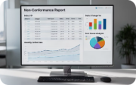

Quality Management
Integrated Quality Assurance
Quality failures in EPC projects lead to rework, delays, and potential safety incidents. The Quality Management module embeds quality controls at every stage of the EPC lifecycle, from incoming material inspection through final customer acceptance. Every inspection, test, and certification is documented with complete traceability.
Incoming Inspection
In-Process Inspection
Final Inspection
Welding Qualification Tracking
Material quality verification against purchase specifications before warehouse acceptance prevents defective materials from entering inventory
Stage-wise quality checks during manufacturing ensure problems are caught early when correction costs are minimal
Pre-dispatch inspection with test certificates ensures only conforming products reach customers
Welder certification management and procedure qualification records ensure compliance with codes and standards
NCR & Defect Management
Calibration & Compliance Records
Non-Conformance Reports with root cause analysis and corrective action tracking drive continuous improvement
Instrument calibration schedules and compliance documentation maintain audit readiness and measurement accuracy
Value Delivered: Reduced rework costs, improved customer satisfaction, and enhanced audit readiness create a quality culture supported by systematic processes and complete documentation.

Slide 13

Manufacturing Control Sheet
Shop-Floor Performance Monitoring
The Manufacturing Control Sheet provides real-time visibility into shop floor execution, enabling supervisors and managers to identify bottlenecks, address delays, and optimize resource utilization. This comprehensive dashboard transforms abstract manufacturing data into actionable insights that drive daily decision-making.
94%
87%
23
156
On-Time Completion
First-Pass Yield
Active Work Orders
Labor Hours
Jobs completed within scheduled timeframe
Products passing quality inspection without rework
Currently in production across all work centers
Deployed today across manufacturing operations
Key Monitoring Capabilities
Operational Impact
Job-Wise Progress Tracking: Real-time status of each work order with completion percentage and remaining operations
Target vs Achievement Analysis: Planned versus actual production quantities highlighting performance gaps
Delay Alerts: Automated notifications when jobs fall behind schedule enable proactive intervention
Defect Analysis: Quality issue tracking by work center, operator, and product type reveals improvement opportunities
Efficiency Metrics: Labor productivity, machine utilization, and throughput analysis optimize resource allocation
Shop floor supervisors use the Manufacturing Control Sheet as their primary management tool, starting each day with a review of delayed jobs and resource constraints. The visibility enables them to reassign resources, expedite critical components, and communicate realistic delivery dates to project managers.
Over time, the performance data accumulates to reveal patterns—which products consistently take longer than estimated, which work centers are bottlenecks, which operators achieve the highest quality rates. This intelligence drives targeted training, process improvements, and capacity investments.
Value Delivered: Real-time productivity insights enable proactive shop floor management, reducing delays and improving manufacturing throughput.

Slide 14

Dispatch & Logistics
Controlled Delivery Management
The final mile of project execution—getting manufactured products or procured materials to the right site at the right time—requires meticulous planning and documentation. The Dispatch & Logistics module ensures complete control over delivery operations while maintaining compliance with regulatory requirements for documentation and invoicing.
01
02
03
Dispatch Planning
Export & Domestic Documentation
E-Invoice & E-Way Bill
Load optimization and route planning based on delivery priorities, vehicle capacity, and site access constraints
Automated generation of packing lists, shipping bills, and customs documentation for domestic and international shipments
Integrated GST compliance with electronic invoice generation and E-Way Bill creation directly from dispatch orders
04
05
Transport Tracking
Delivery Status Monitoring
Real-time visibility into shipment location and estimated arrival times through GPS integration and transporter updates
Proof of delivery capture with customer acknowledgment and exception reporting for damaged or rejected shipments
Compliance & Efficiency
Customer Visibility
The system's integration with GST infrastructure eliminates manual data entry for invoicing and E-Way Bill generation, reducing errors and ensuring compliance with regulatory deadlines. Automated documentation workflows mean that a dispatch clerk can process shipments in minutes rather than hours.
Customer portals provide real-time visibility into order status, dispatch schedules, and delivery tracking, reducing inbound queries and improving customer satisfaction. Proactive exception alerts enable customer service teams to address delivery issues before customers even notice them.
Value Delivered: Faster dispatch processing, regulatory compliance, and improved delivery visibility enhance customer satisfaction while reducing administrative overhead.

Slide 15
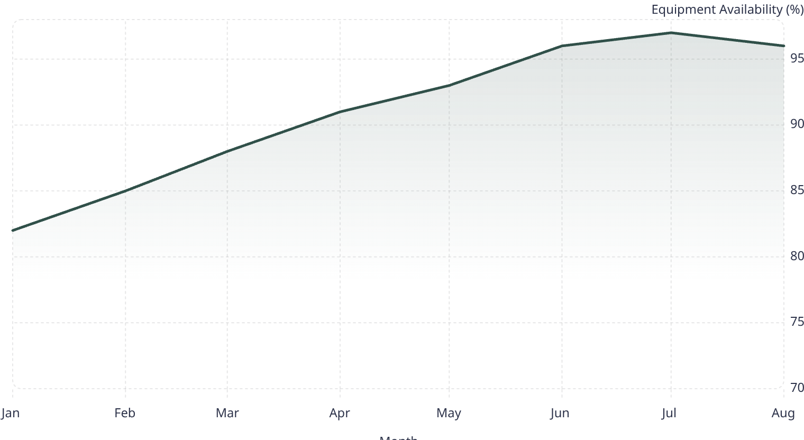
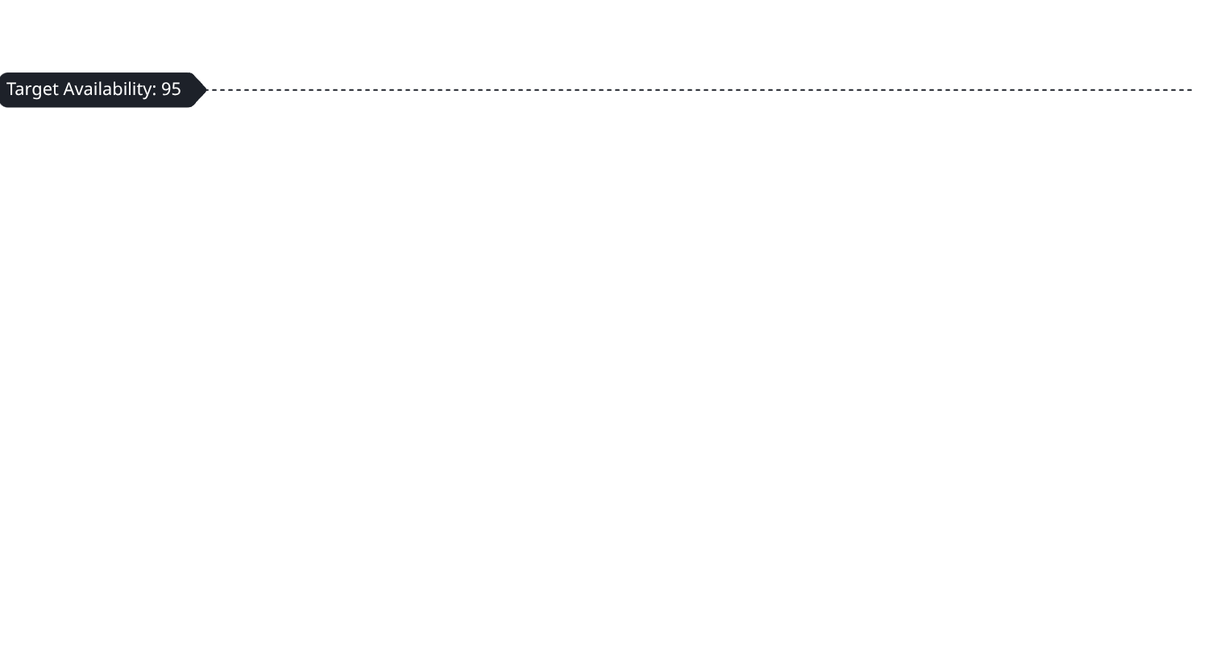
Maintenance Management
Equipment Lifecycle Control
Equipment downtime in manufacturing or construction environments directly impacts project schedules and costs. The Maintenance Management module transitions maintenance from reactive firefighting to proactive asset care through systematic preventive maintenance planning, breakdown tracking, and spare parts management.
Preventive Maintenance
Breakdown Tracking
Spare Parts Control
Warranty & AMC Tracking
Calendar and meter-based maintenance schedules with automatic work order generation ensure equipment reliability
Failure recording with downtime analysis and root cause investigation improves asset performance over time
Critical spares inventory management ensures rapid repair capability while minimizing inventory investment
Vendor warranty and Annual Maintenance Contract management ensures timely claims and service utilization
Maintenance Cost Analysis
Equipment-wise maintenance spending visibility supports repair-versus-replace decisions and budgeting
The chart demonstrates how systematic preventive maintenance drives sustained improvements in equipment availability, with organizations typically achieving target availability levels within 6-8 months of implementing structured maintenance programs.
Value Delivered: Reduced unplanned downtime, extended asset life, and predictable maintenance costs transform maintenance from a necessary expense into a strategic capability that supports reliable operations.

Slide 16

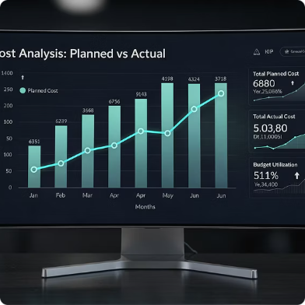
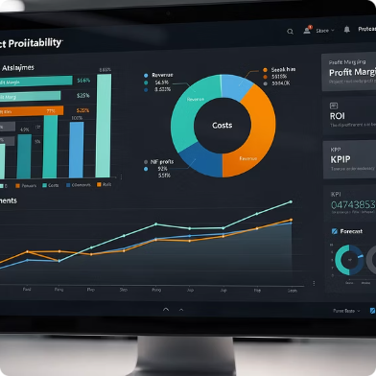
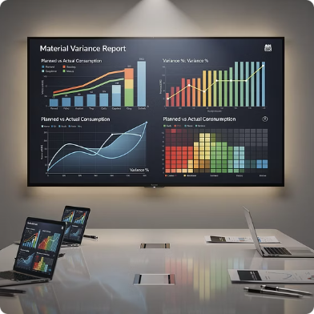
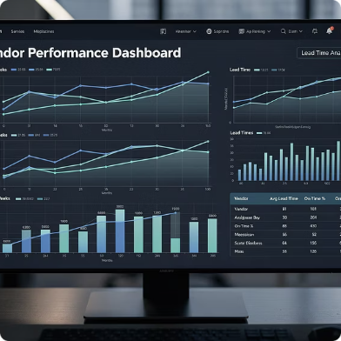
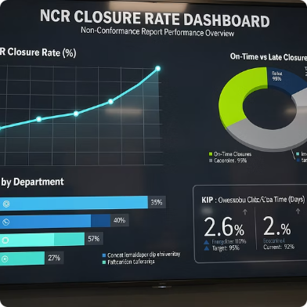
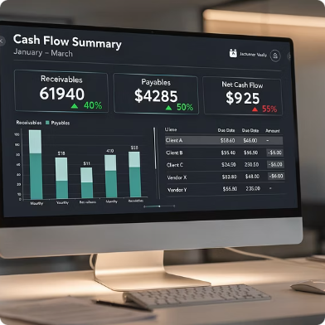
Dashboards & Decision Intelligence
Real-Time Executive Insights
Data without insights is merely information clutter. The Dashboards & Decision Intelligence capabilities transform your operational data into actionable intelligence that empowers executives and managers to make informed decisions rapidly. Role-based dashboards provide the right information to the right people at the right time.
Planned vs Actual Cost
Project Margin Analysis
Material Variance Dashboard
Vendor Lead Time Tracking
Project-wise variance analysis highlights cost overruns early, enabling corrective action before margins evaporate
Real-time profitability tracking shows which projects contribute to the bottom line and which need attention
Planned versus actual material consumption reveals wastage patterns and procurement inefficiencies
Supplier delivery performance metrics identify reliable vendors and problematic relationships
NCR Closure Rate Monitoring
Cash Flow Position View
Non-conformance resolution speed indicates quality culture maturity and customer satisfaction risk
Working capital visibility across projects and vendors supports liquidity management and payment planning
Value Delivered: Proactive, data-driven decision-making replaces reactive crisis management. Executives gain the visibility they need to steer the organization confidently, while managers receive the insights required to optimize daily operations.

Slide 17

Industry Applicability
Designed for EPC Segments
Merciglobal Cloud ERP is purpose-built for project-centric, manufacturing-intensive environments where complexity is the norm. While the system is flexible enough to adapt to various industries, it delivers exceptional value in EPC segments characterized by large-scale projects, custom engineering, and multi-disciplinary execution.
Power Projects
Oil & Gas
Infrastructure
Thermal, renewable, and transmission projects requiring integrated engineering, fabrication, and site execution capabilities
Upstream, midstream, and downstream projects with stringent quality, safety, and documentation requirements
Transportation, water, and urban infrastructure projects demanding complex scheduling and resource coordination
Heavy Engineering
Industrial Fabrication
Capital equipment manufacturing and industrial plant construction with extensive custom fabrication needs
Structural steel, pressure vessels, and process equipment manufacturing requiring weld traceability and material compliance
The common thread across these industries is the combination of project-based operations with manufacturing or construction intensity. Organizations managing multiple concurrent projects, each with unique specifications, timelines, and resource requirements, benefit most dramatically from the system's integrated capabilities.

Slide 18






Business Impact
Measurable Performance Gains
The true measure of an ERP system's value lies not in its features but in its business impact. Organizations implementing Merciglobal Cloud ERP consistently report measurable improvements across key performance indicators that directly affect profitability, competitiveness, and customer satisfaction.
18%
12%
Faster Delivery
Cost Reduction
Improved project delivery timelines through better coordination and visibility
Reduction in cost leakage from wastage, rework, and procurement inefficiencies
35%
100%
Procurement Speed
Margin Visibility
Faster procurement cycles from requisition to delivery reducing schedule delays
Real-time profitability visibility enabling proactive margin protection
23%
42%
Less Wastage
Better Coordination
Aligned to EPC KPIs
Sustained Improvement
These improvements directly address the four critical dimensions that determine EPC organizational success:
Improved cross-department coordination reducing handoff delays and errors
Reduced material wastage through better planning and consumption tracking
Unlike one-time process improvements that fade over time, ERP-enabled transformation creates sustainable change. The system enforces best practices, captures organizational learning, and provides the visibility needed for continuous improvement.
Cost Control: Reduced leakage and better procurement translate to improved margins
Time Management: Faster delivery cycles enhance competitiveness and customer satisfaction
Quality Assurance: Less rework and wastage improve first-time-right execution
Cash Flow Optimization: Better billing and collection processes strengthen working capital
Organizations report that the performance gains accelerate over time as users become more proficient with the system and as historical data accumulates to enable predictive analytics and benchmarking.

Slide 19

Implementation Approach
Structured Rollout Model
ERP implementation success depends more on methodology than technology. Merciglobal follows a proven, low-risk implementation approach that minimizes business disruption while ensuring user adoption and realizing early benefits. The phased deployment strategy allows organizations to build capability progressively rather than attempting a high-risk "big bang" go-live.
Process Study & Gap Analysis
Detailed assessment of current processes, pain points, and requirements to ensure solution alignment with business needs
Solution Blueprint
Design of future-state processes, system configuration, and integration architecture with stakeholder validation
Phased Module Deployment
Sequential rollout of modules—typically starting with core functions like procurement and inventory—to build confidence and learn incrementally
Data Migration & Validation
Structured approach to master data creation and transaction history migration with quality checks and user verification
User Training & Change Management
Role-based training programs combined with communication and leadership engagement to drive adoption
Go-Live & Stabilization
Cutover execution with onsite support during initial weeks to address issues rapidly and build user confidence
Implementation Success Factors
Scalable Strategy
Executive sponsorship and visible leadership commitment
Dedicated internal project team with decision-making authority
Realistic timelines that balance speed with thoroughness
Early wins through pilot projects or priority modules
Continuous communication about benefits and progress
The phased approach allows organizations to start small—perhaps with a single project or business unit—and expand as confidence and capability grow. This reduces implementation risk while providing proof points that build organizational support for broader rollout.
Most organizations complete their initial deployment within 4-6 months, with additional modules and sites added over subsequent quarters as the internal team gains expertise and best practices emerge.

Slide 20

Why Choose Merciglobal Cloud ERP?
Purpose-Built for EPC Complexity
Generic ERP systems force EPC organizations to adapt their unique workflows to fit standardized modules. Merciglobal Cloud ERP takes the opposite approach—it's specifically designed to accommodate the complexity, variability, and project-centric nature of EPC operations. Every feature, workflow, and integration has been crafted with deep understanding of how EPC businesses actually operate.
BOQ-Driven Project Control
Project-Wise Costing & Inventory
Bill of Quantities serves as the foundation for estimation, procurement, execution, and cost tracking throughout the project lifecycle
Every transaction—material, labor, overhead—is tracked by project, enabling true project profitability analysis
Engineering-to-Procurement Linkage
Integrated Manufacturing & Site Execution
Design specifications automatically flow into purchase orders, ensuring procurement matches engineering requirements
Seamless data flow from shop floor production through logistics to site installation and commissioning
Real-Time Margin Tracking
Enterprise-Grade Dashboards
Live visibility into project profitability enables proactive margin protection and informed decision-making
Executive, operational, and analytical dashboards provide the right insights to stakeholders at every level
Transform Your EPC Operations
Next Step
The question is not whether to implement an integrated ERP system—the complexity of modern EPC operations makes it essential. The question is which system will truly address your unique challenges while positioning you for growth and competitive advantage.
Schedule your ERP readiness assessment and live demonstration
Merciglobal Cloud ERP represents a strategic investment in operational excellence, margin protection, and scalable growth. Organizations that implement it don't just improve processes—they fundamentally transform how they execute projects, serve customers, and compete in demanding markets.
Experience firsthand how Merciglobal Cloud ERP addresses your specific challenges. Our team will conduct a detailed assessment of your current operations and demonstrate how the system would work in your environment.
Contact us to begin your digital transformation journey.

